Slide 1

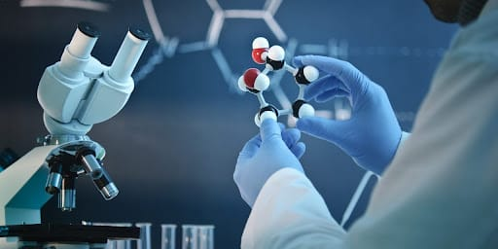
Applications of Biotechnology
Name : Liyanage L.H.K
Module code: SC1172
Module name: Introduction to Information
Technology

Slide 2
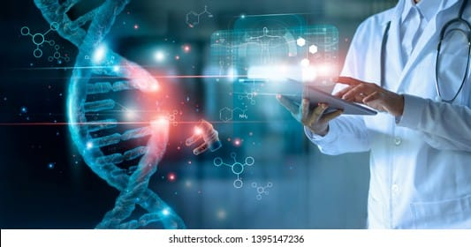
What is Biotechnology?
Biotechnology is most briefly,
‘’ the art of utilizing living organisms and
their products for the production of food,
drink, medicine or for other benefits to the
human race, or other animal species.’’
Biotechnology applies the knowledge of biology
to enhance and improve the environment,
health, and food supply.
BIOTECHNOLOGY
In the coming years, most
of the commercial application of
biotechnology will be in three markets.
Medical
Agriculture
Environment

Slide 3
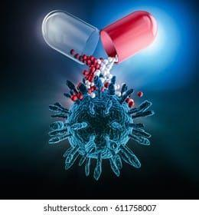
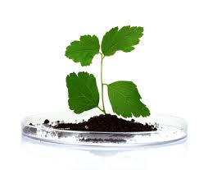
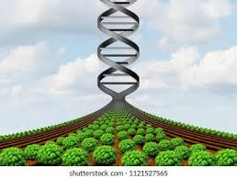
Applications of Biotechnology
Medical Biotechnology
Pharmaceutical drugs / Diagnostics
Therapeutics
Vaccines
Agriculture Biotechnology
Plant Agriculture
Animal Agriculture
Food Processing
Environmental Biotechnology
Cleaning through bioremediation
Preventing environmental problems
Monitoring the environment

Slide 4
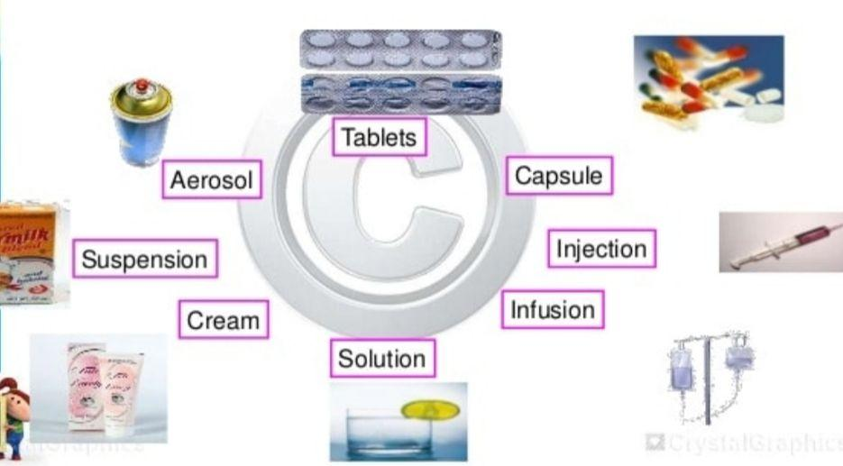
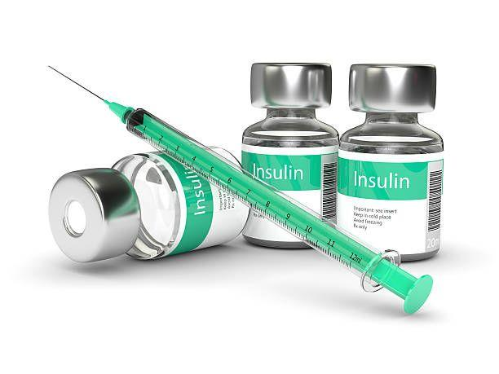
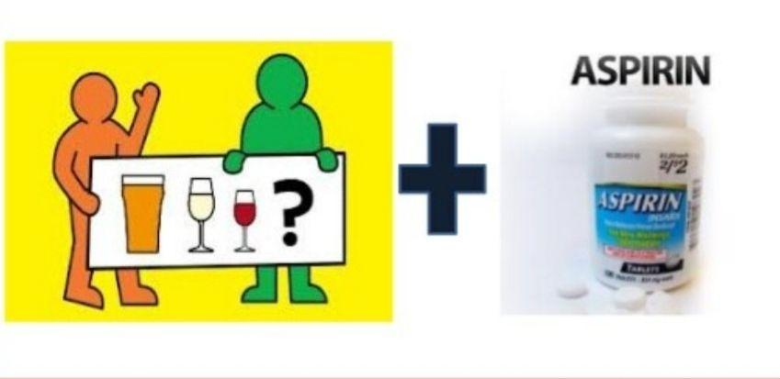
Pharmaceutical Drugs of Medical Biotechnology
What are pharmaceutical drugs ?
It is defined as a substance that is used for prevention, diagnosis, treatment and cure of the disease in animals and humans.
Morphine
Insuline
Penicillins
Asprin
Drug
Production & Interaction
By genetic engineering
Alcohol + Aspirin = Pain relief
Notes:
Here introduce, that what are pharmaceutical drugs?, Examples of drugs dosage forms, Drug production and drug interaction and some of examples.

Slide 5
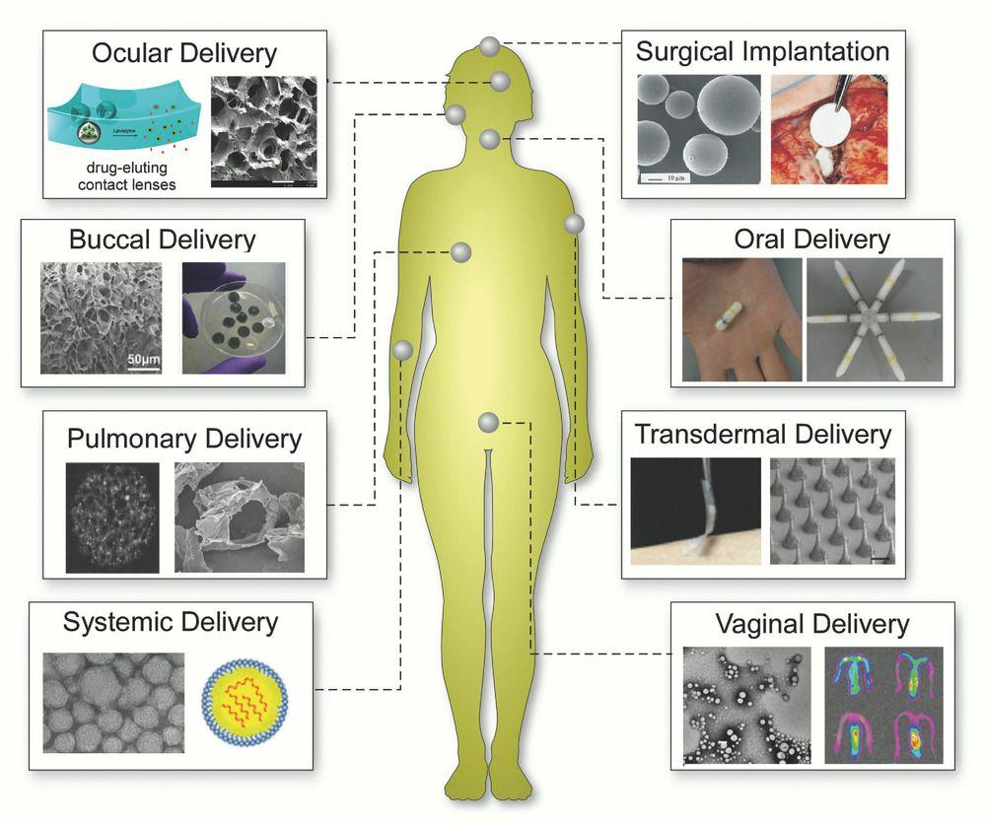
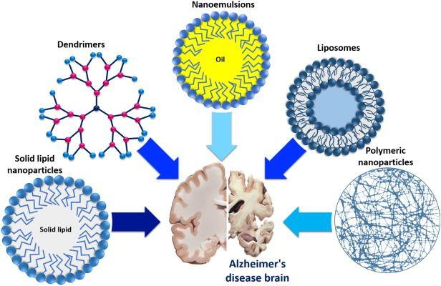
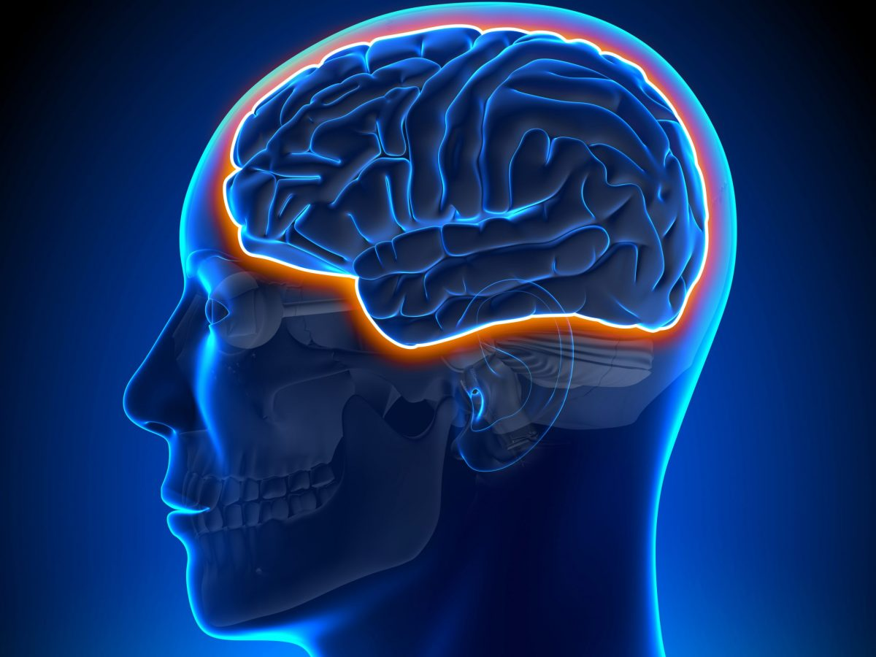
What is a drug delivery system or DDS ?
A drug delivery system is a system that is used as a medium or carrier for administering a pharmaceutical product to a patient.
Gravity of DDS in health
Notes:
Here introduce that what is drug delivery systems and examples and about gravity of gravity of delivery systems in health.

Slide 6
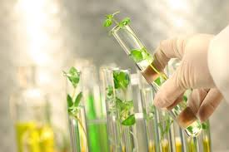
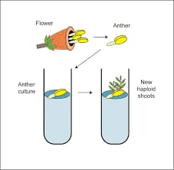
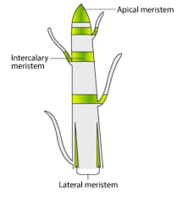
Tissue Culture of Plant Agriculture
What is plant tissue culture?
Plant tissue culture is a technique of growing plant cells,
tissues, organs, seeds or other plant parts in a sterile environment on a nutrient medium.
The cells first forms a mass of undifferentiated cells called
callus.
There are two basic types of tissue culture:
Anther culture
Meristem culture

Slide 7
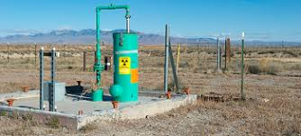
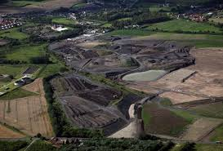
Bioremediation of environmental biotechnology
What is bioremediation?
Bioremediation is a treatment that uses naturally occurring organisms to break down hazardous substances into less toxic or nontoxic substances.
Types of Bioremediation
In in situ bioremediation, contaminants are treated at
the same site Using
biological systems.
In ex situ bioremediation, contaminants are treated in
some other place from
the original site.

Slide 8
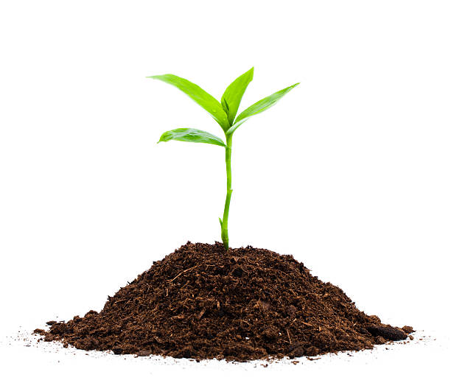
Reference
https://doi.org/10.1007/s10295-018-2027-3
https://onlinelibrary.wiley.com/doi/pdf/10.1002/3527604286.ch1
https://onlinelibrary.wiley.com/doi/pdf/10.1002/3527604286.ch10
https://onlinelibrary.wiley.com/doi/pdf/10.1002/3527604286.ch12
https://www.google.com/search?q=biotechnology+images&tbm=isch&hl=en&chips=q:biotechnology+images,g_1:medical:_edqToE7vNQ%3D&bih=512&biw=360&client=ms-android-lgu-kr&sa=X&ved=2ahUKEwjoibDPuozzAhUYKrcAHYl4BUQQ4lYoBXoECAEQDg
Applications of Biotechnology
Liyanage.L.H.K

